Slide 1
Module 13: Authenticating Users
Siebel Core Developer and Technology School
Notes:
Time: Lecture: 30 minutes; lab: 30 minutes
Intent: To present the concepts of internal and external authentication at a very high level. You should review the Siebel Authentication and Access Control Administration Guide for more information. Students have learned the concepts of Siebel Access Control and have created an organizational hierarchy in the Siebel application. Now they will learn about the different ways a user can be authenticated before accessing the Siebel application.
Flow: The difference between authentication and access; Siebel Authentication Manager; types of authentication; internal authentication; external authentication; benefits of external authentication; Web Single Sign On (Web SSO); and guidelines for using authentication.
Key Terms:
Authentication
Authentication Manager
Internal authentication
External authentication
Security adapter
Authentication service
Web Single Sign On (SSO)
Please note: Faculty-specific notes are italicized.

Slide 2

Module Objectives
After completing this module you will be able to:
  Describe the types of authentication supported by Siebel eBusiness Applications
  Explain the role of the security adapter
  Select an authentication strategy for your implementation
Why you need to know:
  To effectively manage users across applications, you need to understand the available options for authentication
Notes:
Each objective and “why you need to know” should be stated aloud.

Slide 3
Authentication
Refers to the verification of users prior to letting them access a Siebel application
May be handled by a security adapter, which:
  Collects credentials, such as user name and password
  Verifies credentials against a master data store
Notes:
Students learned about Access Control in previous modules. This module focuses on authentication.

Slide 4
Security Adapters
Are plug-ins that authenticate users
  Parameters are stored in named subsystems
Can be configured to meet specific business needs
  New Security Adapters can be built using Siebel Security Adapter Software Developers Kit
Notes:
The Security Adapter Software Developers Kit (SDK) is a published set of APIs for building custom security adapters.
Standard security adapters are provided for database authentication as well as LDAP and ADSI.
Custom security adapters may be built to authenticate users against other kinds of data sources.

Slide 5
Authentication Options
Siebel applications support three authentication options
  Database authentication
  Directory server authentication
  Web Single Sign On
Notes:
This is a positioning slide. Don’t discuss each point in detail—the authentication options will each be discussed in detail in the following slides.

Slide 6
Database Authentication
Uses a security adapter for the Siebel database
Is the default for Siebel applications
Browser
Web Server
1. User provides name and password
SWSE
Credentials
Siebel Object Manager
2. Password may be encrypted to prevent direct database access
Encrypt password
3. Connect to database
Connect using DB account
Siebel
Database
Notes:
With internal authentication, the credentials (username and password) are collected in the Siebel login form and are verified against an account on the database server. A database (DB) account (login and password) must be created for each user on the database. Because of the requirement for database accounts, database authentication does not support dynamic user registration.
This is an unattractive option for application deployments that include a large number external users, since you do not want to have to create database accounts for each of them.
Encryption prevents users from accessing the Siebel database directly.
Password encryption can be handled using a proprietary mangling operation that generates an encrypted version of the password by shifting the bits and then performing a numerical calculation or through the use of industry standards such as RC2 encryption.
You can also encrypt data between the browser and the Web server by using Secure Socket Layer (SSL). For more information see the Security Guide for Siebel eBusiness Applications.

Slide 7
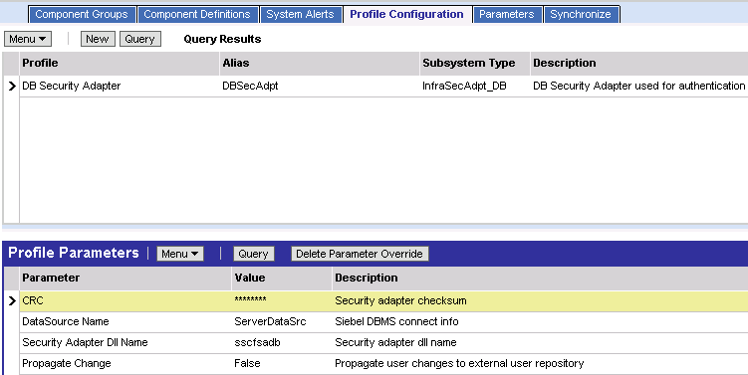
Database Security Adapter
Parameters are contained in the DB Security Adapter named subsystem
Notes:
The Database Security Adapter is called by the object manager, and authenticates the username and password provided against the database.
Object Managers read parameters for security adapters from named subsystems.
The Database Security Adapter named subsystem contains parameters such as the name of the .dll file that connects to the data source, and the ODBC data source it connects to.

Slide 8
Database Authentication Benefits
Does not require additional infrastructure components
May support account policies
  Password expiration
  Password syntax
  Account lockout
Notes:
The database may support the account policies listed in the slide.

Slide 9
Database Authentication Considerations
Uses a separate database login for each user
  Requires ongoing support from a database administrator
Supports minimal user self-management
Notes:
Database authentication is common in development environments like the classroom, but production systems commonly perform authentication against an external data store.

Slide 10
Directory Server Authentication
Browser
Uses a security adapter for a directory server containing user credential and administrative information
Typically uses a single reserved database login for all users
Web Server
SWSE
1. User provides information
Credentials
2. Verify credentials
Siebel Object
Manager
Security
adapter
Login
Authentication Service
Retrieve DB Account
Directory
Connect using DB account
Siebel
Database
3. Connect to database
Notes:
Here are the steps for this type of authentication:
The user credentials are collected and passed to the security adapter.
The security adapter makes a call to the authentication service to verify the credentials.
The security adapter retrieves a database account and optionally, a set of roles, which are applied to the user as Siebel responsibilities.
A connection is made to the application database using the database account information.
The information returned from the external directory is (1) the Siebel user ID of the user logging in, (2) database credentials (username and password), and optionally (3) the views the users will see via roles specified in the directory.
Directories are simply a method of organizing information, such as phone book or email address. Directories can be used for many things. In this context, they are a collection of users, user passwords, and the resources they can access.
One advantage of using the external method of authentication is that it can be also be used for other enterprise applications such as PeopleSoft, SAP, and so on.

Slide 11
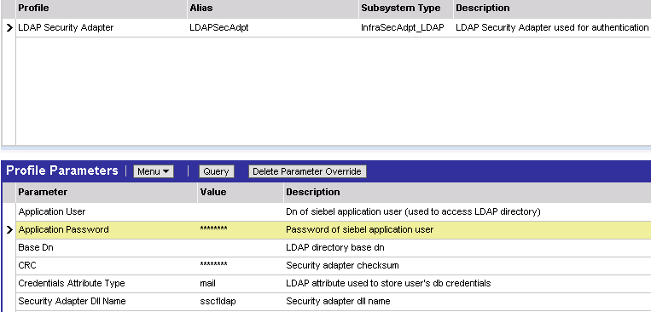
Directory Server Security Adapters
Are defined as enterprise profiles with parameters such as:
  The location of the directory server
  The attributes containing user and password information
  The reserved database login used by the object manager to connect to the database
Notes:
Directory Server Security Adapters are called by the object manager, and authenticate the username and password provided against an external directory server.
Object Managers read parameters for security adapters from named subsystems.
There are two directory server named subsystems – LDAP Security Adapter and ADSI Security Adapter. They contain parameters such as the name of the .dll file that connects to the external directory, and the attributes in the directory that contain user data.

Slide 12
Reserved Database Login
A reserved database login is used for all users who are authenticated externally
  Must not be assigned to any real user
An LDAPUSER database login is automatically created as part of the standard Siebel installation
Notes:
The LDAPUSER password is created as part of the grantusr.sql script and should not be modified.

Slide 13
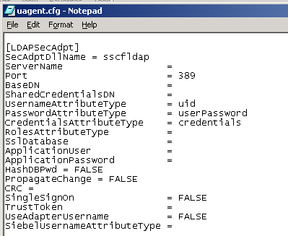
Directory Server Authentication for Mobile Web Clients
Security adapter is specified by a named section in the application .cfg file
  Name and parameters correspond to those in the corresponding enterprise profile
Notes:
It is important to highlight that this slide refers to the Mobile Web Client software (siebel.exe) using the Dedicated Web Client architecture.
Dedicated Web Clients can use directory server authentication.
Mobile Web Clients cannot use directory server authentication.

Slide 14
Directory Server Authentication Benefits
Reduces administrative overhead
  Eliminates maintenance of a separate database login for each user
  Allows Web users to self-register and maintain login information
  Allows automated creation of users from User Administration view
  Allows external delegated administration of users
Allows credentials store to be shared across multiple applications
May support account policies
  Password expiration
  Password syntax
  Account lockout

Slide 15
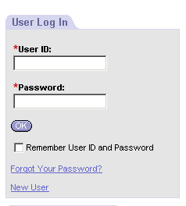
Directory Server Authentication Benefits Continued
Allows Web users to maintain their login information
  Reduces burden on system administrator to maintain user login information
  Common in customer applications
Enter user ID and password for authentication
Click here for
forgotten password
Click here to self-register
Notes:
External authentication supports dynamic user registration, where users can be created in real time either through self-registration processes or administrative views.

Slide 16
Web Single Sign On
User authentication is performed by third-party service at Web server level
Siebel applications still access directory server to retrieve DB account
Browser
1. User provides information
User Credentials
Web Server (Auth Client)
Authentication Service
Login
SWSE
2. Verify credentials
Authenticated User ID
and trust token
3. Passes authenticated
User ID and trust token
Siebel Object
Manager
Security
adapter
Directory
4. Verifies trust token and collects User ID
Connect using DB account
Siebel
Database
5. Connect to database
Notes:
Authentication manager can be configured to accept user identifiers authenticated by third-party services, such as:
Netegrity Site Minder
IBM Tivoli Policy Director
Oblix NetPointer
Entrust Get Access
A comprehensive list can be found in the Siebel System Requirements and Supported Platforms guide in Bookshelf.

Slide 17
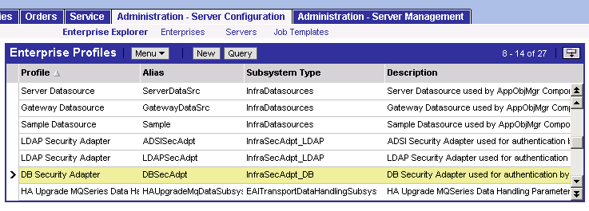
Web Single Sign On Continued
Uses credentials that are collected and verified by the web server
Requires the use of a Trust Token
  Secret value shared by the Web Server and Object Manager
Notes:
Trust Tokens help prevent unauthorized access to the Siebel Server. They prevent Web Servers from spoofing the Object Manager into believing a user has been authenticated.

Slide 18
Web Single Sign On Benefits
Allows user to access Siebel applications without any further login
Allows Siebel applications to be deployed into existing Web sites and portals
Notes:
Web Single Sign On takes advantage of existing authentication mechanisms and improves the end user experience by limiting the frequency with which they enter their credentials.

Slide 19
Web Single Sign On Considerations
The following Siebel User Administration features are not available and should be disabled for consistency
  User self-registration
  Delegated administration of users
  Login forms
  Logout links
  Change password
Requires synchronization of users between the Siebel application and the external authentication system
Notes:
In web single sign on, authentication happens outside of the Siebel application. Therefore, user administration must take place outside the Siebel application, too.

Slide 20
Summary
This module showed you how to:
  Describe the types of authentication supported by Siebel eBusiness Applications
  Explain the role of the security adapter
  Select an authentication strategy for your implementation
Notes:
Review Question: Which authentication mechanism is used in the classroom?
Answer: Database authentication.

Slide 21
Lab
In the lab you will:
  Explore application authentication and distinguish it from access control
  Use Query Analyzer to create a database account
  Use the Call Center application to administer access control
  Explore application behavior before and after a database user account has been created
Notes:
See lab instructions for details.
Labs and Troubleshooting
The lab does not address user registration. The lab also does not address setup and configuration of external directories (for example, LDAP), because it is not necessary in this training environment.

